Slide 1
Introductie in de informatica
Wednesday 24th January 2024

Slide 2
Agenda
Kennismaking
Grading - Tentamen Mode
Fundamentals C++
Variables

Slide 3
Intro.
BSc Elektrotechniek, Informatietechniek
MSc Computer Science, Specialized in IT Managers
Werkzaam:
Senior Software Engineer @ Ford Motor Company (Focus: AI, ML, Web Development).
AI Engineer @ Merck (Farmaceutische bedrijf) (Focus: LLM).

Slide 4
Kennismaking
Naam
Achtergrond
Ervaring met programmeren?

Slide 5
Grading - Tentamen Model
Deel Tentamen(10%) + Tentamen (30%) + Project (40%)
Assignments (10%)
Class Participation (10%)

Slide 6
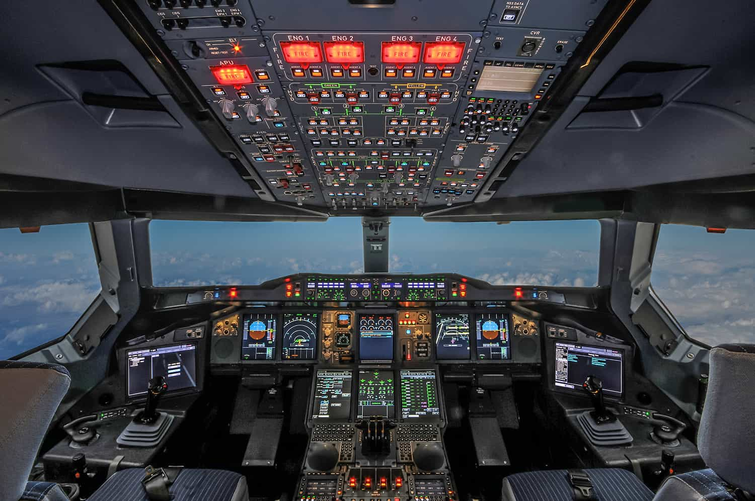
Fundamentals C++

Slide 7
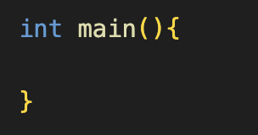
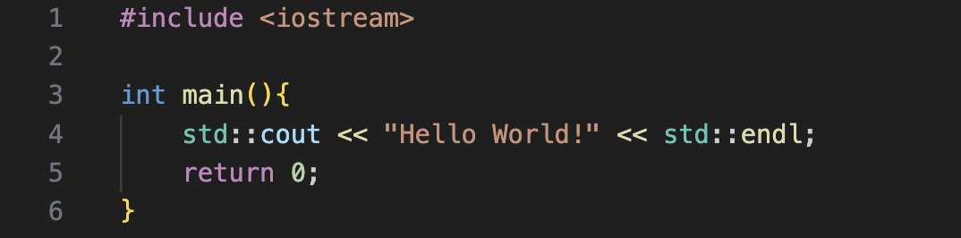
Fundamentals C++
Entry Point
Case sensitive
Structure int {” ”} main

Slide 8
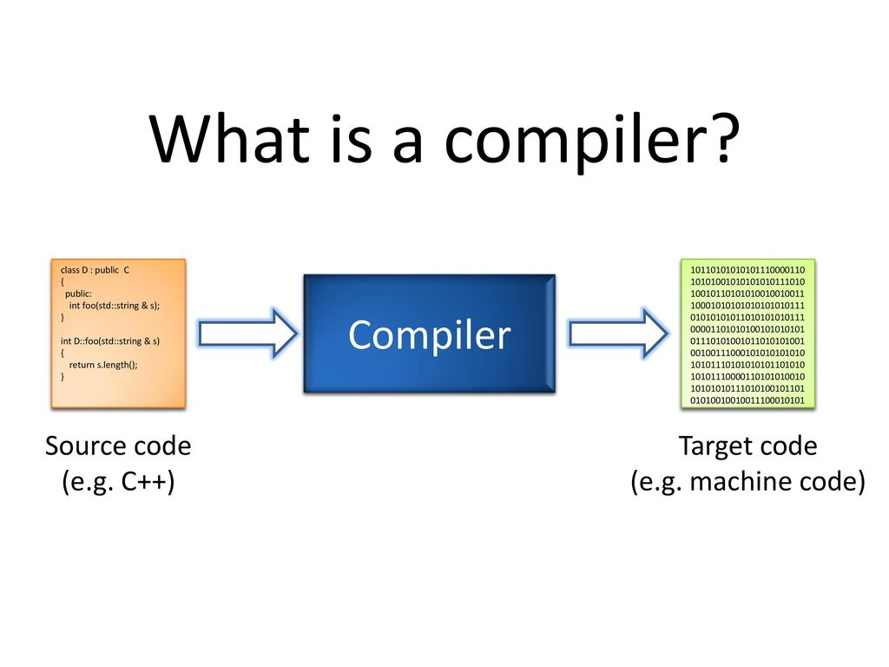
Fundamentals C++

Slide 9
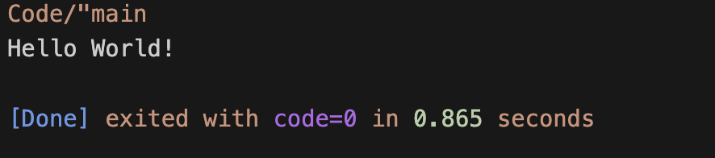
Fundamentals C++

Slide 10
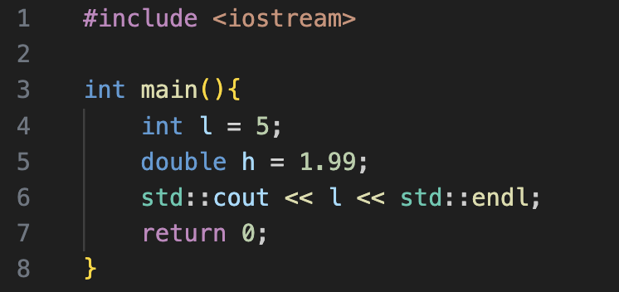

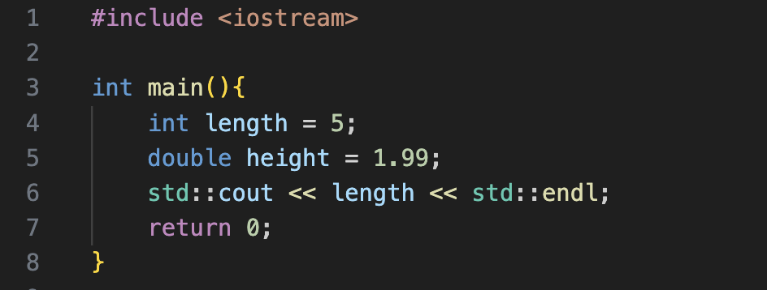

Variables

Slide 11
Opdracht
Github Registratie

Slide 12
Vragen?

